Slide 1
Academia
Presented By
Kiran Chamaraja
Gaurav Sonkar
Akash Bangera

Slide 2

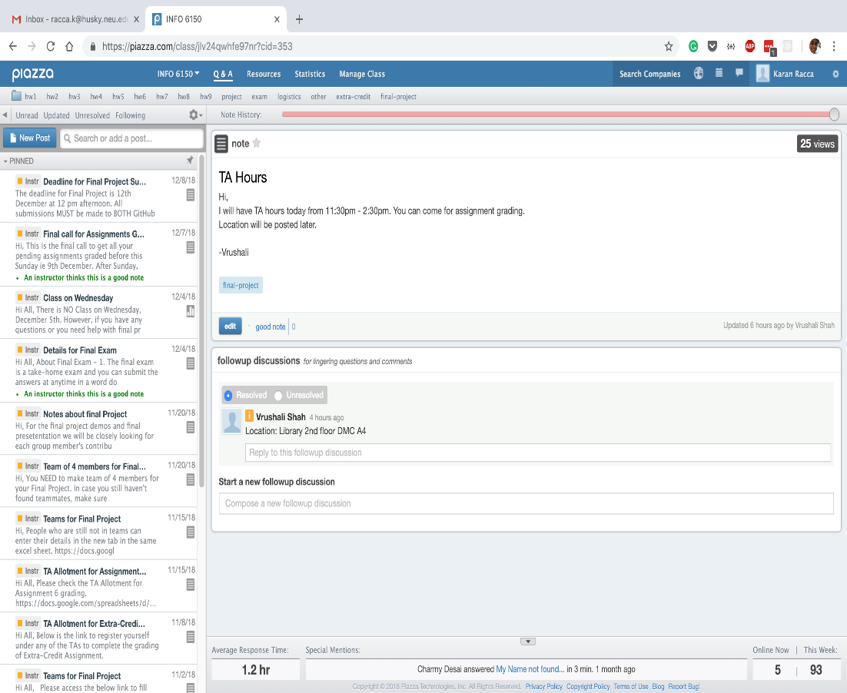

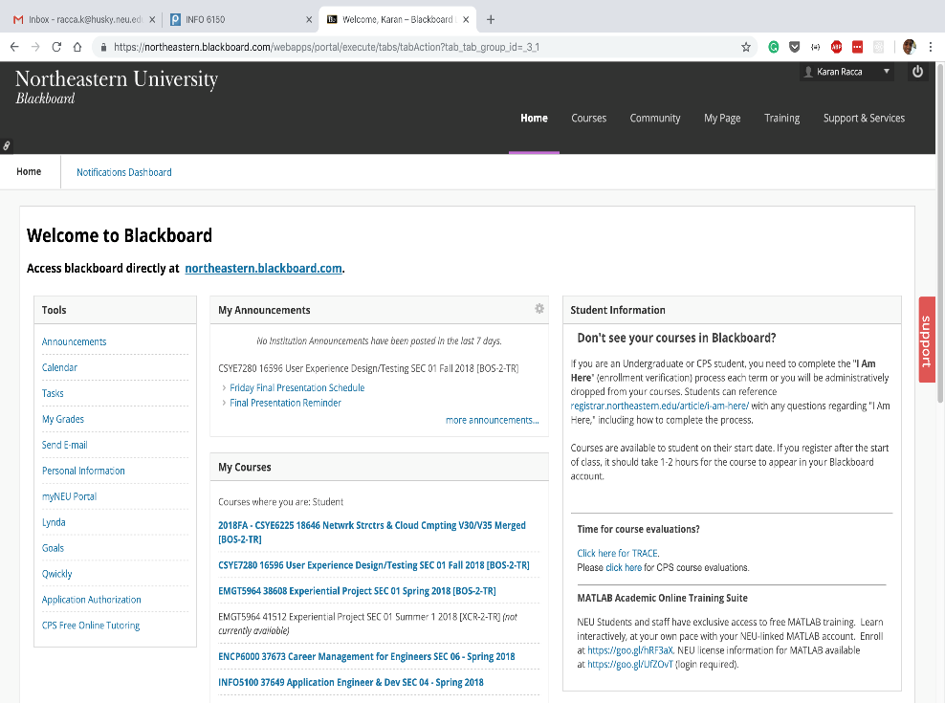
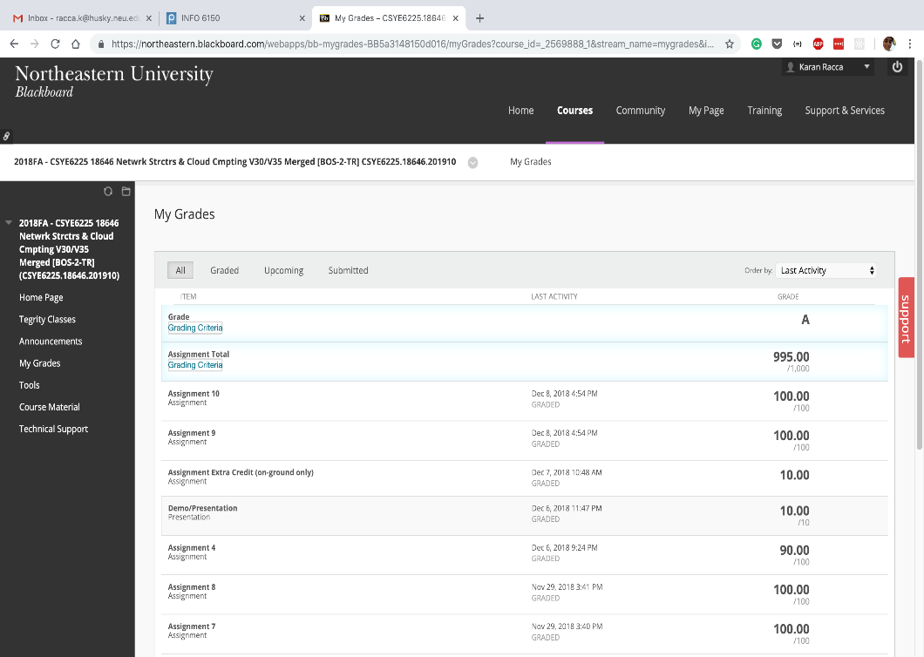

Current Systems
Bad User Experience
Unnecessary complexity, Boring , Lack of user
engagement, Infrequently updated
Lack of Needs Assessment
Lacking user specific services
Redundant Advantages
Multiple Solutions to solve single
problem

Slide 3
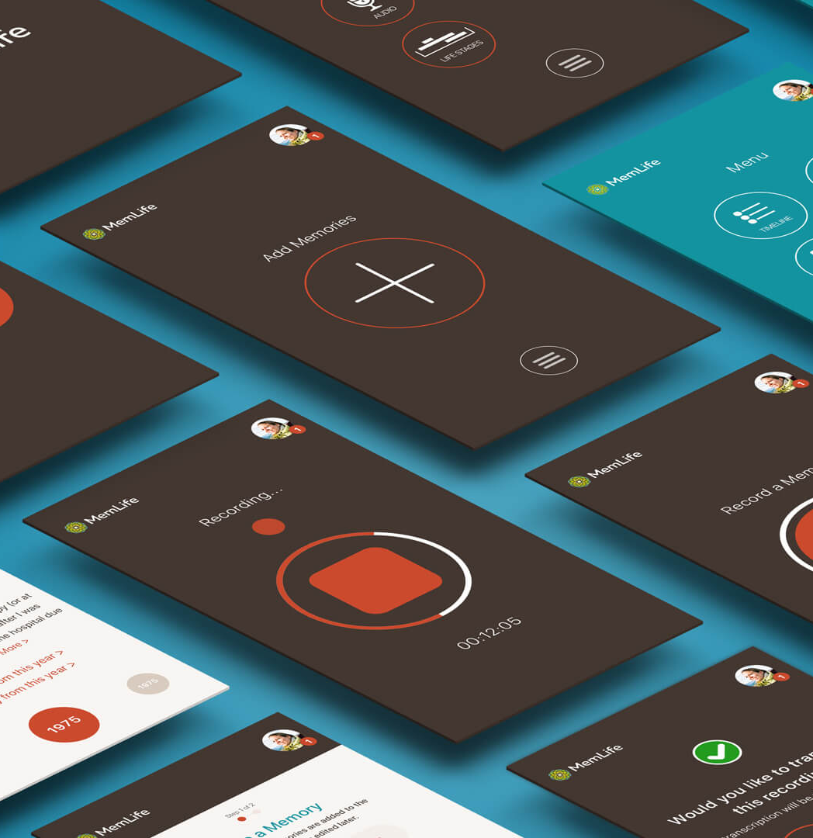
Our Solution
Single solution
A single integrated solution to avoid use of multiple platforms and increase productivity
Design
Improve visual appeal and reduce number of clicks to fulfill various user needs
Personalization
Institutional oriented platform
Data Analytics
Informative data analysis based on performance and resource utilization

Slide 4
Elements of
User Design

Slide 5
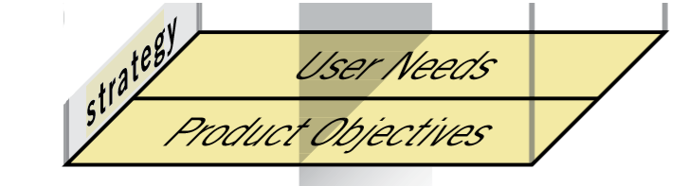
Strategy Plane
Goal – To overcome technical and functional flaws and enhance user interface, thus providing a great user experience
User Needs – User wants new functionalities like one platform for course access and discussion forum, better visual performance metrics. All these requirements have been taken into consideration while re-designing website
Lab Testing & User feedback – Method used to explore how users perform and experience of site users
Creating Personas – A persona is a fictional character used to represent the needs of a whole range of real users

Slide 6
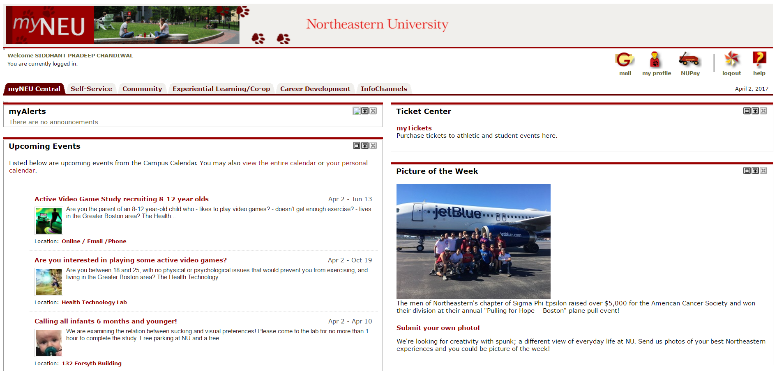
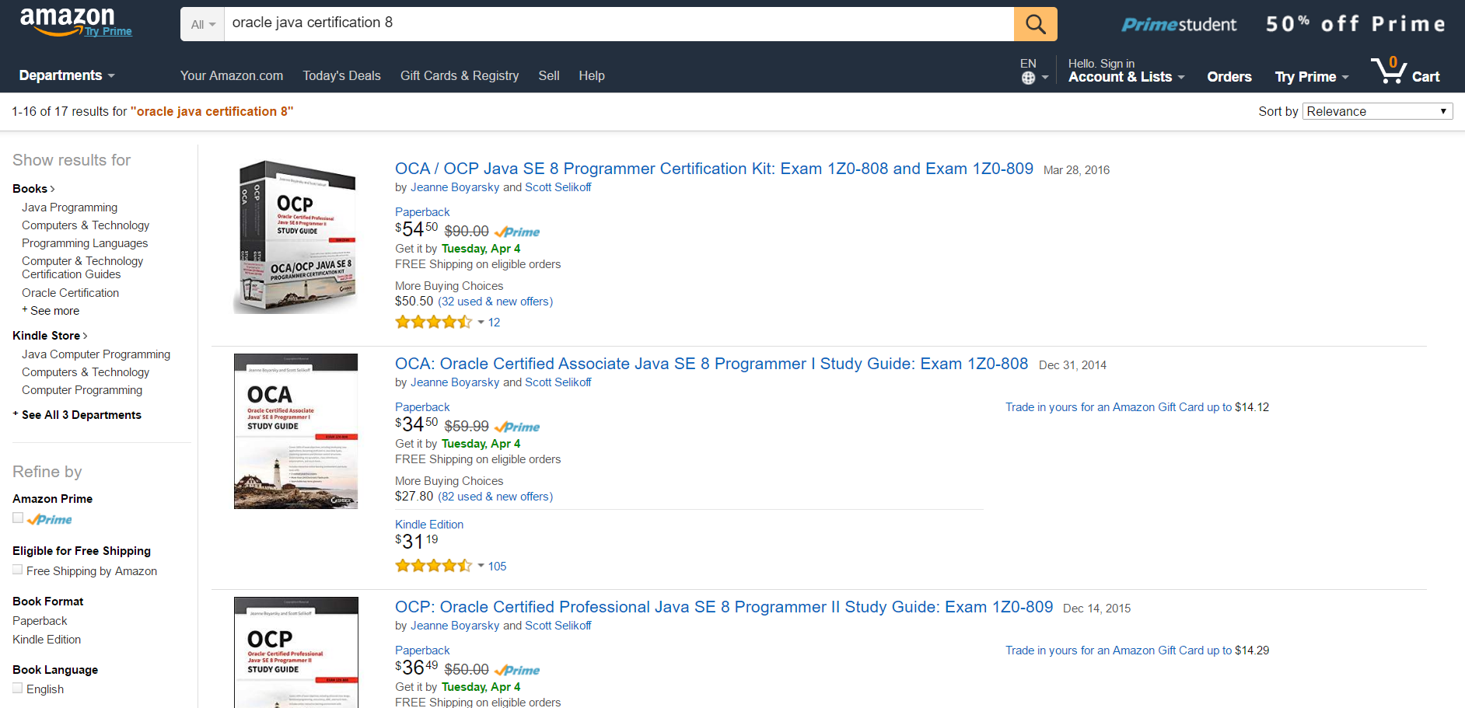
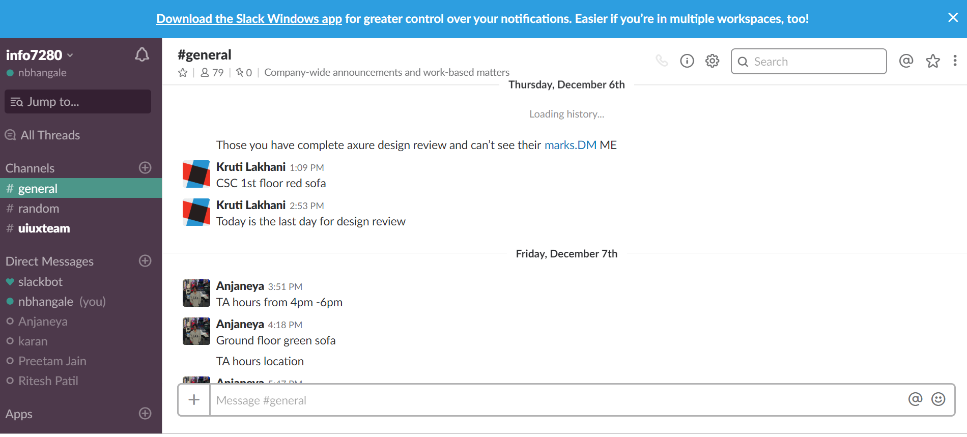
Abhishek Rao
Instructor
I am Information Systems Graduate Student at Northeastern University. I am presently a Teaching Assistant at Northeastern University.
Abhishek is frustrated with the using UI which is too hard to manage at a higher overview with options of grading in Blackboard. The weekly notifications are very much narrowed down and nil at times. Abhishek feels that he requires a better platform for this purpose.
Age: 24
Education: Masters In Information Systems
Family: Single
Technical Profile: Java, UI/UX, C, C#, Python, MS SQL Server, Oracle11g, MySQL, Apache Spark
Internet Use: 100% at Campus; Educational, Shopping, Entertainment
Favorite Sites:
myneu.neu.edu
amazon.com
slack.com

Slide 7
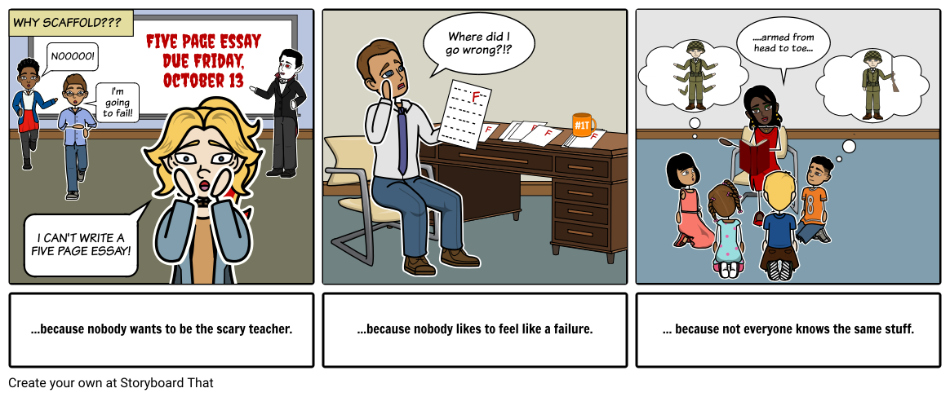
Storyboard 1

Slide 8
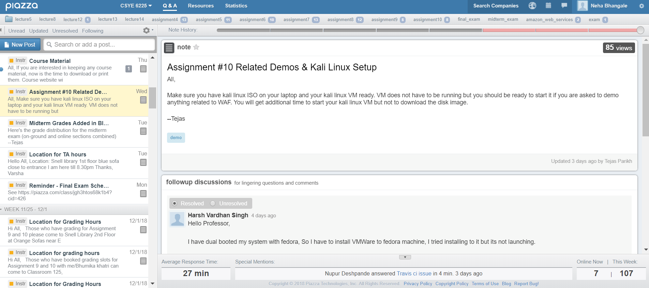
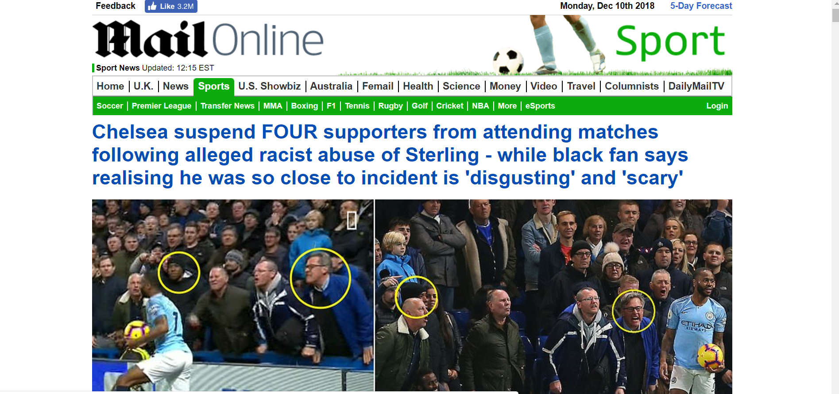
Student
Shubham Nag
I am Information Systems Graduate Student at Northeastern University. I am working as a Software Developer at Indeed
Shubham is facing issues with accessing multiple platforms.He found that it is hard to be in sync on all the apps and stay updated.This has made the issue much more complex and hard to manage. Shubham feels that there should be hierarchical UI for this forum
Age: 24
Education: Masters In Information Systems
Family: Single
Technical Profile: Java, Spring Framework,C, C#, Python, MS SQL Server, MySQL, Apache Spark
Internet Use: 50% at Home; Educational, Sports, Entertainment and rest on campus
Favorite Sites:
myneu.neu.edu
piazza.com
dailymail.com

Slide 9
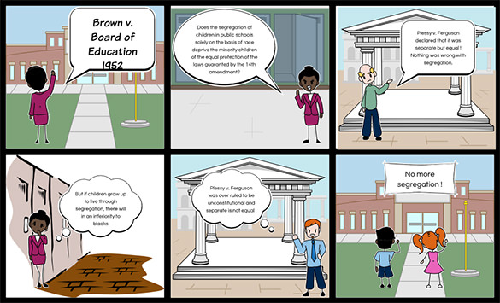
Storyboard 2

Slide 10
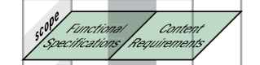
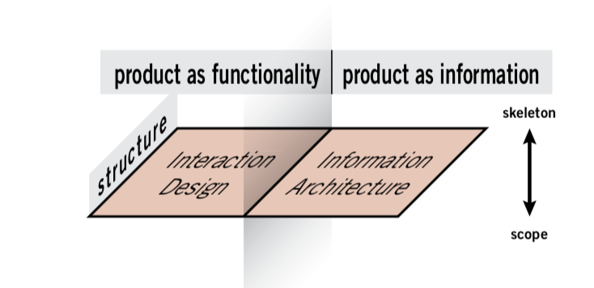
Scope Plane
Structure Plane
Mission
Single Platform solution with rich user experience coupled with good performance for educational institutions
Business Goals & Brand Identity
Access courses
Discussion forum
All features packed in one place
User friendly Design
Future scalable design
Resource Management
Success Metrics
Institutions Enrolled
User Engagement
Features Utilization
Referrals
Structure plane helps us in describing better user experience and define better user experience for the user in consideration.
Flawless navigation between links and guide to obtain the desired goals at specific needs of the user into consideration.
The UI of the website is crystal clear to engage users in each components.
Makes the website easy to use for end-user
User Segmentation
Staff
Student
Professor

Slide 11
Information Architecture

Slide 12
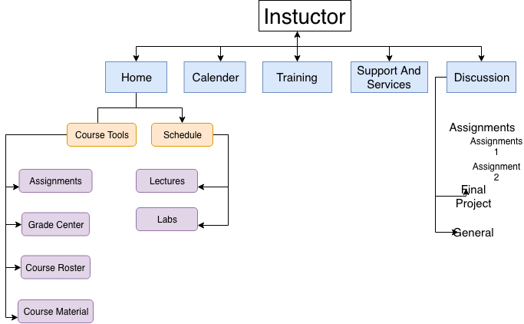
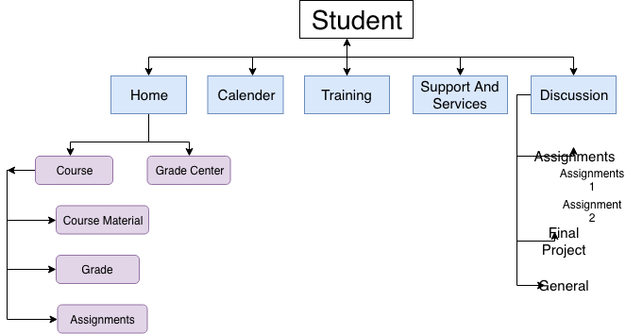
Visual Hierarchy
Academia
Audience schemes
The type of content organization for separate groups of users.
Student
Instructor
Category Sorting

Slide 13
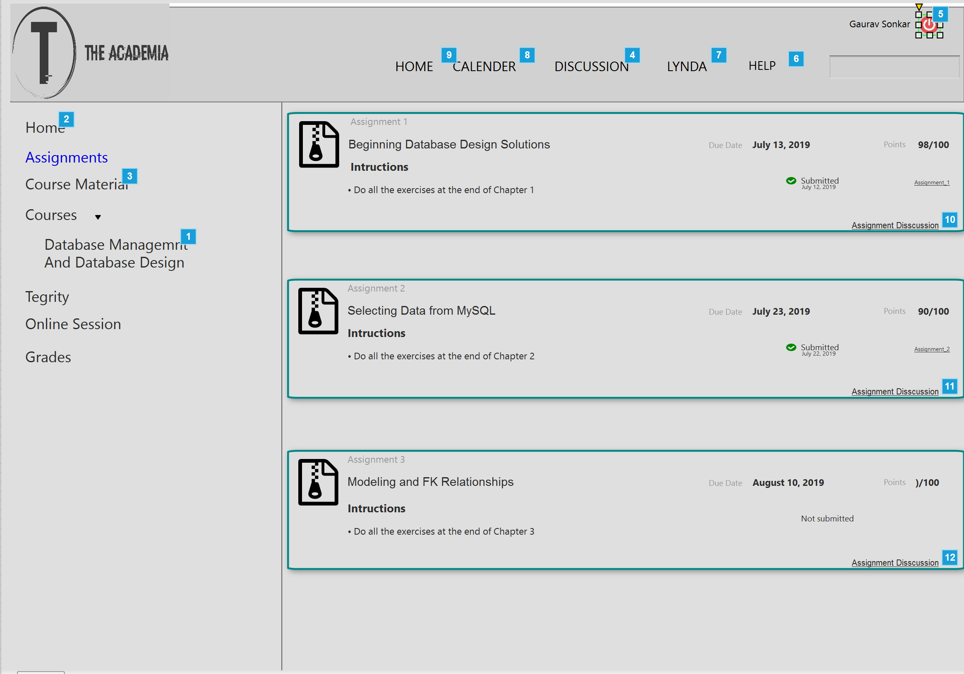
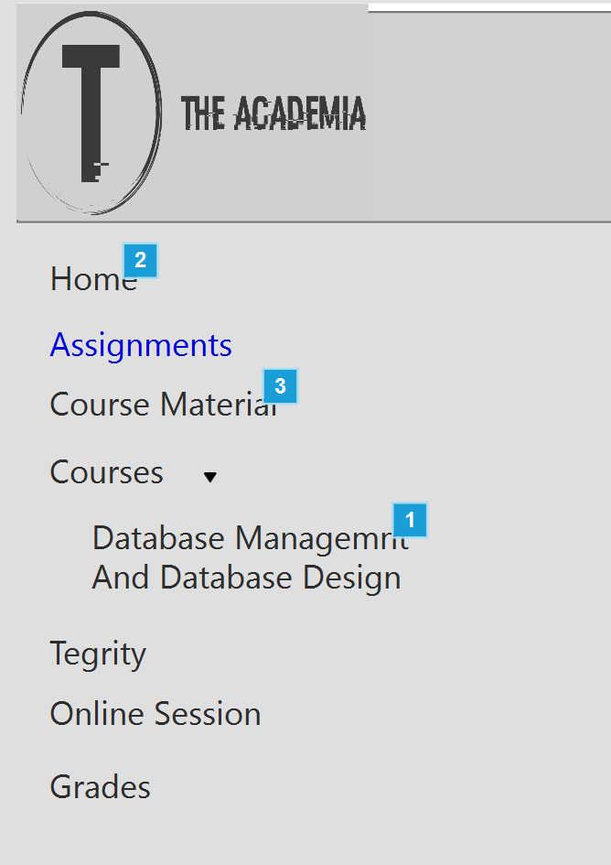
Navigation Sorting
Category Sorting

Slide 14
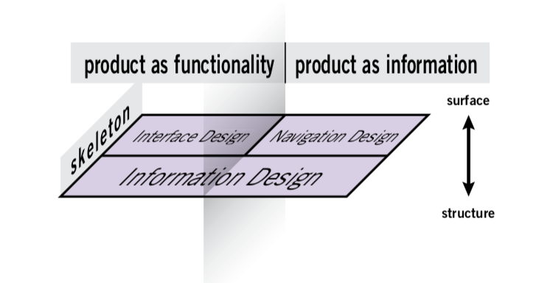
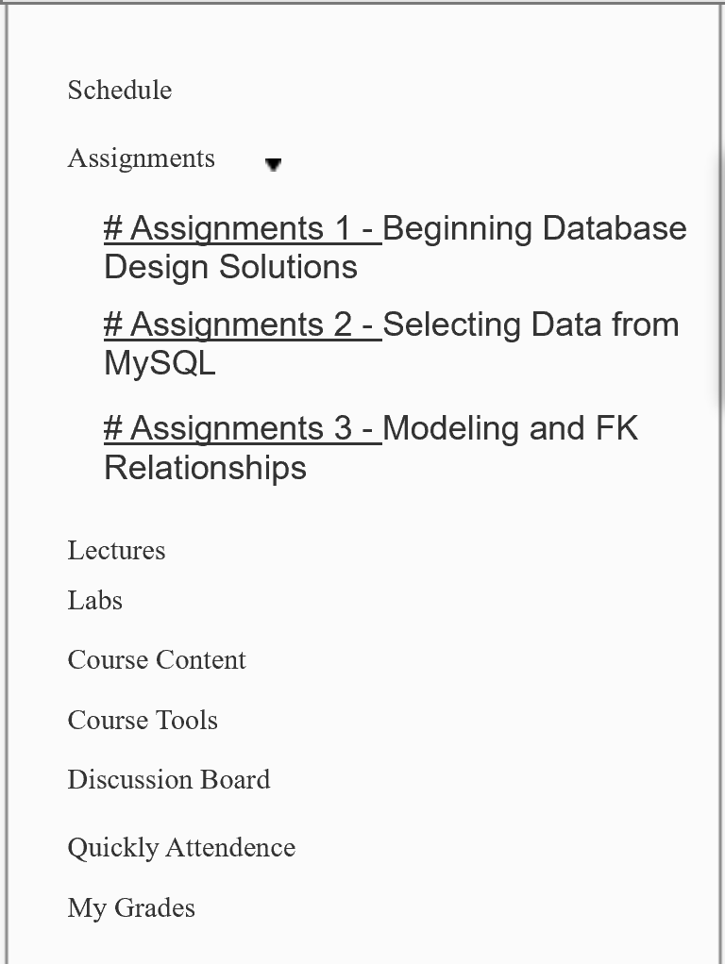
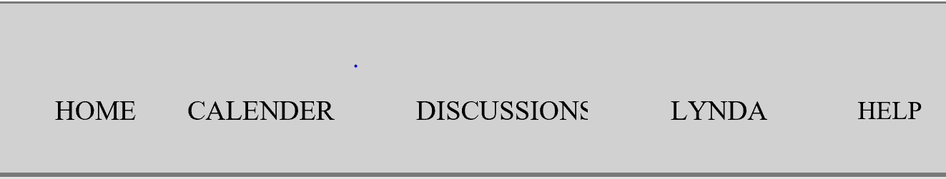
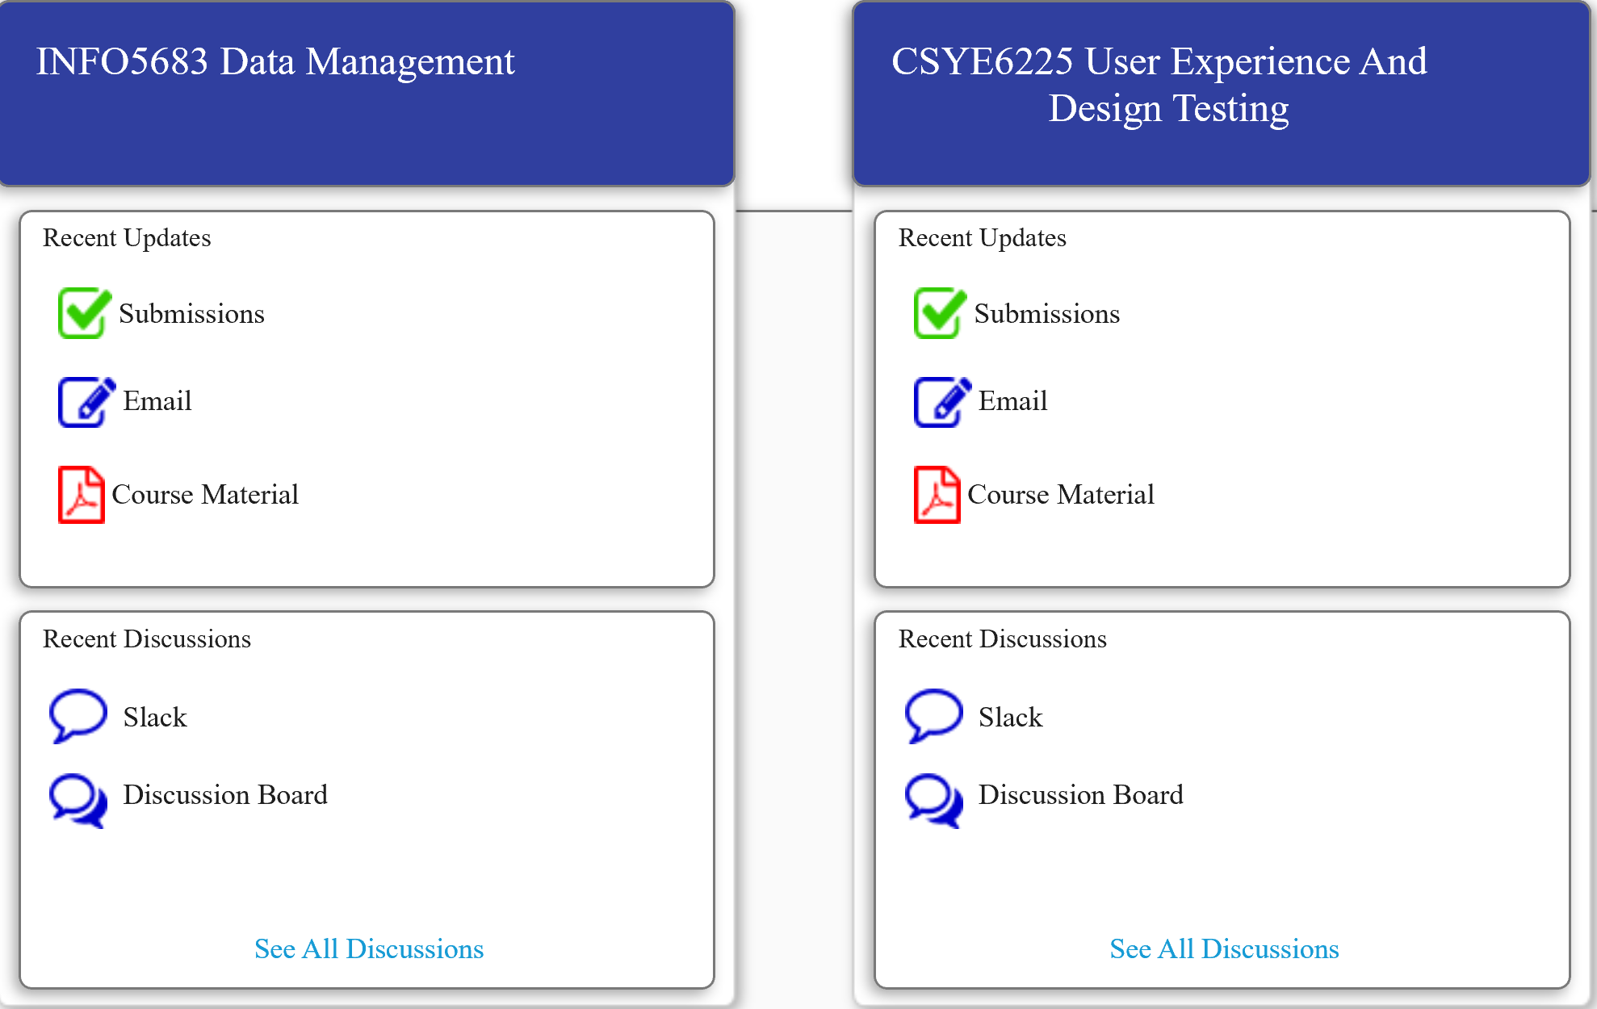
Skeleton Plane
The skeleton plane defines what form that functionality will take. We define the skeleton through Interface design
Navigation design is the specialized form of interface design tailored to presenting information spaces.
Local Navigation
Global Navigation

Slide 15
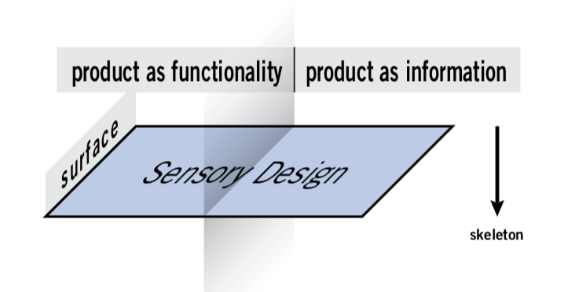
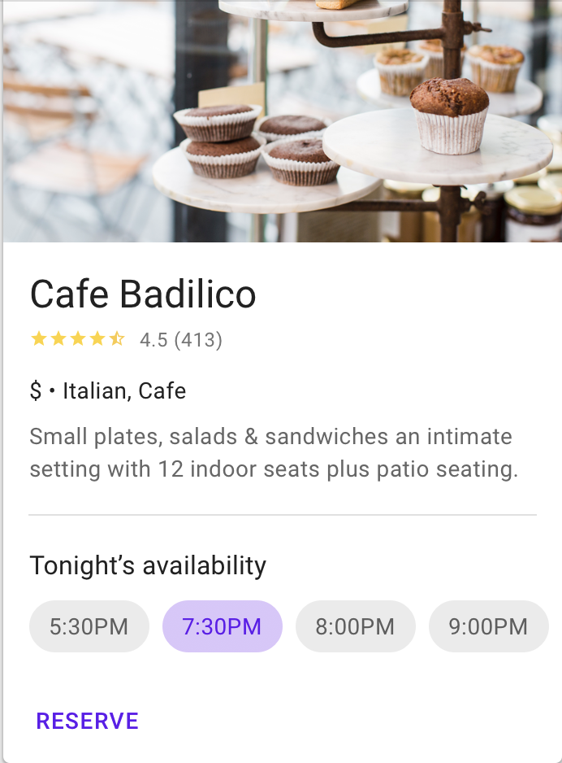

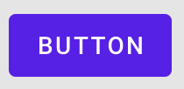
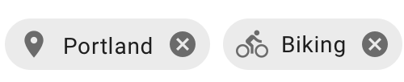
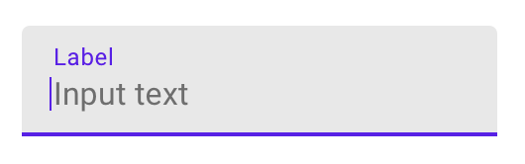
Surface Plane
We are dealing with the sensory design and presentation of the logical arrangements that make up the skeleton of the product.
Google Material Design
Color Pallet
Action Buttons
Buttons
#303F9F
#333333
#FFFFFF
Chips
Typography
Ayuthaya (Regular)
Card
Input Field

Slide 16
UI Design Principles

Slide 17
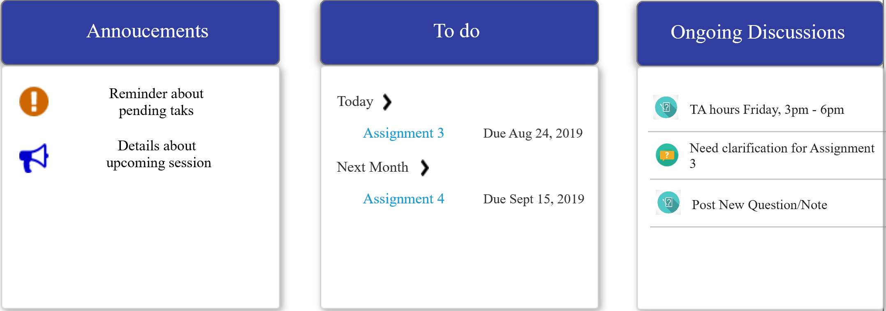
Social Validation - User Reviews
Clarity - User should not be confused between the object. He should be to easily able to focus on the work which he wanted to do.
Consistency – The consistency in maintained throughout the app on mobile and web.
Scarcity - As you can see the less available items seems to be more valuable –
e.g. - Assignment submission Page
5. Familiarity - Icon which are used in day to day life.

Slide 18
UX Research Methods

Slide 19
Usability Lab Studies
Task ID | Avg time(mins)
Courses Viewing | 2
Access the course content of the course | 27
Access Assignments | 20
Access university calendar | 5
Raise questions/notes in discussion board | 35

Slide 20
User Feedback Survey
A Customer Feedback or VoC study is aimed at collecting ‘true’ data on participants who visit a site and provides us with valuable insight into what your users/customers think about our product. This insight can help you create a product that users want to buy and create an amazing user experience that exceeds expectations and encourages them to come back again
When the user logs out from Blizz
We present a feedback form to
capture user feedback to gain
useful insights to
help improve the
user experience

Slide 21
Survey Analysis

Slide 22
Lets Look at the Wireframes

Slide 23
Questions?

Slide 24
THANK YOU

